Slide 1
Problem Statement The sales pipeline conversion percentage at TechnoServe (a tech SaaS startup) has dropped from 35% at the end of last fiscal (FY 2017-18) to 25% at present.
Notes:
Problem Statement

Slide 2
Sales Pipeline Conversion at a SaaS Startup
Who?
TechnoServe is a B2B tech SaaS startup. The people involved are the sales team, marketing team, and their enterprise/SMB clients across 7 Indian cities.
What?
The sales pipeline conversion rate has dropped from 35% to 25% currently meaning fewer leads are turning into paying customers.
When?
The drop happened after the end of FY 2017-18 and is continuing into the present.
Where?
Across TechnoServe's sales operations in 7 cities: Mumbai, Delhi, Bengaluru, Chennai, Hyderabad, Kolkata, and Pune.
How?
The drop is visible in the sales pipeline data fewer opportunities are reaching "Won" status compared to the previous year.

Slide 3
Sales Pipeline Conversion at a SaaS Startup
Situation
1.What does your current sales pipeline look like?
2.Which technology solutions make up the majority of your pipeline?
3.How many sales reps do you have and which channels?
Problem
1.At which stage of the sales funnel do most leads drop off or go cold?
2.Are your reps struggling more with converting new clients or retaining existing ones?
3.Which sales channels are consistently underperforming and why?
Implication
1.How much revenue is TechnoServe losing annually due to the 10-point drop in conversion?
2.If the conversion rate keeps falling, how will that affect your annual growth targets?
3.How is poor conversion affecting team morale and sales rep retention?
Need-Payoff
1.If we could double the conversion rate on your best-performing channel, what would that mean for revenue?
2.How valuable would it be to focus your team only on leads most likely to convert?
3.If we could identify and fix the top 2 reasons for lost deals, how quickly could you hit your 35% target again?
Notes:
Provide at least three questions under each branch.

Slide 4
Sales Pipeline Conversion at a SaaS Startup
Framework Used
MECE Issue Tree (Hypothesis Tree)
Reason for using the selected framework
The MECE principle (Mutually Exclusive, Collectively Exhaustive) ensures that every possible cause of the conversion drop is covered without overlap. This framework is ideal for breaking down a business KPI problem into distinct branches so each root cause can be investigated independently.
How you have used the framework here
The central problem (conversion rate drop from 35% to 25%) is placed at the root. It is then broken into 5 branches that cover all dimensions of the business — Sales Channels, Product, Pricing, Client Relationships, and Competition. Each branch is then broken into specific hypotheses that can be tested with data.
Notes:
All the frameworks that are used should be mentioned.
A suitable reason is a must to provide here

Slide 5
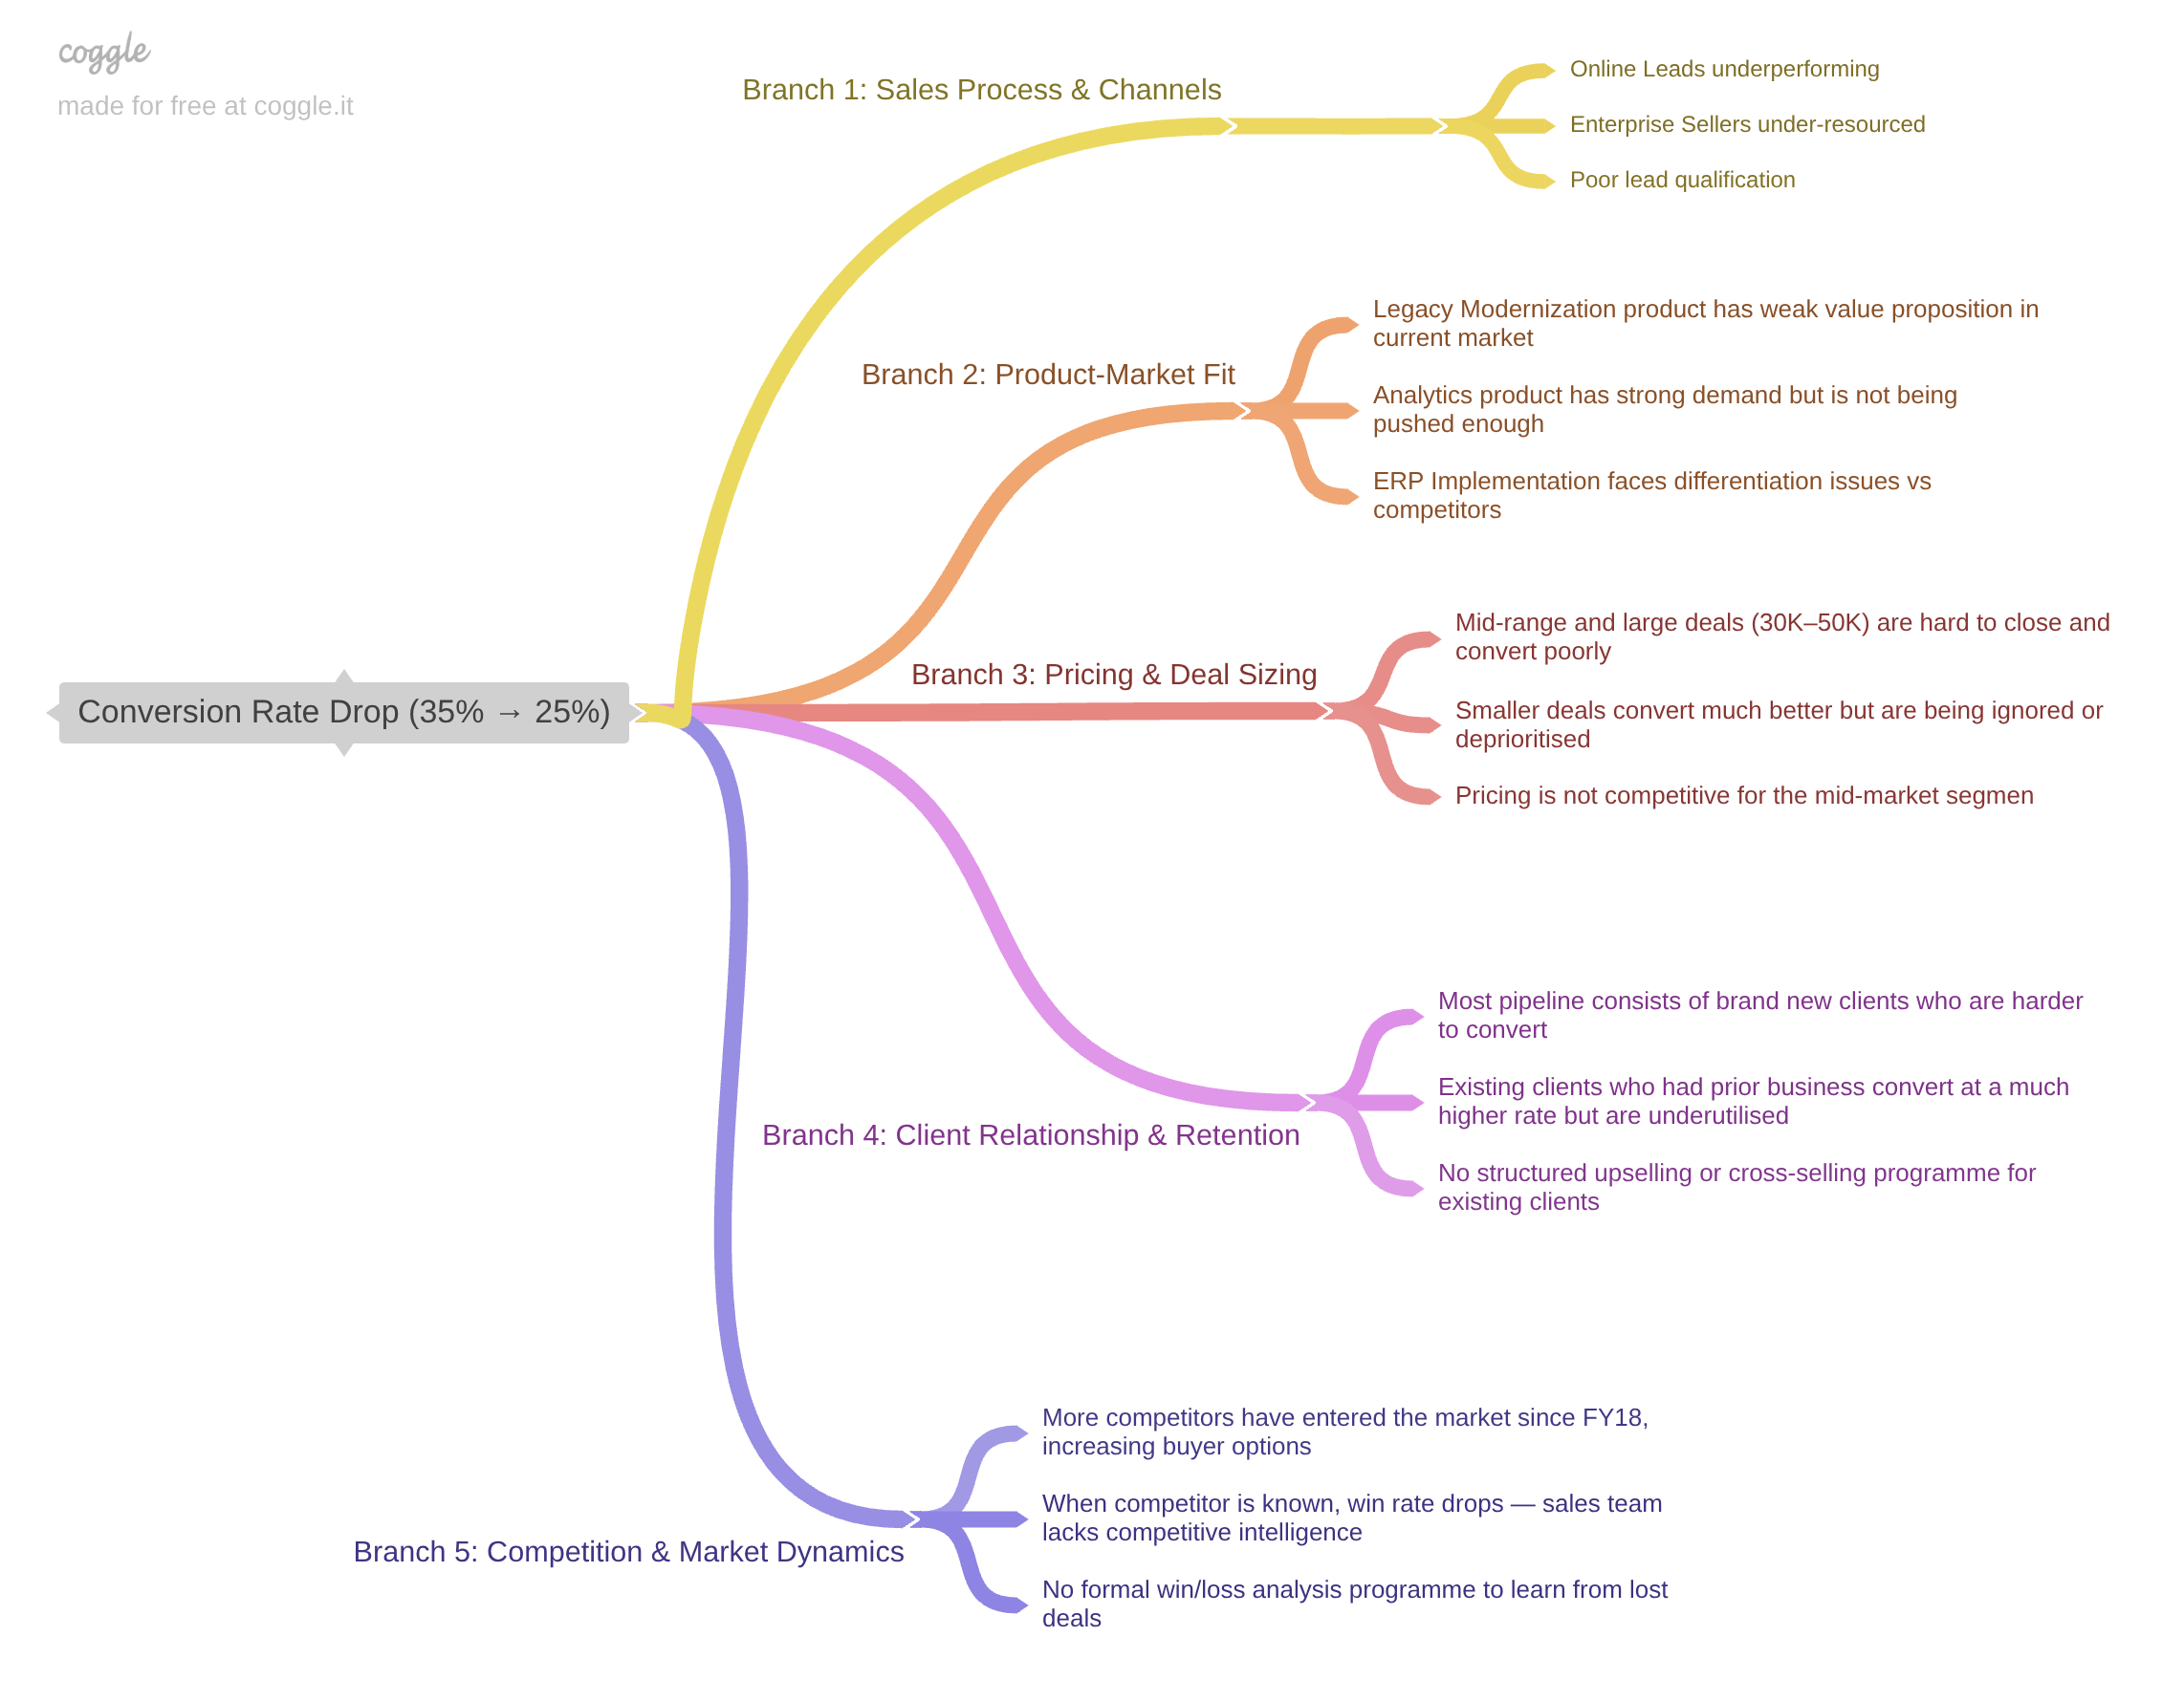
Sales Pipeline Conversion at a SaaS Startup
Notes:
Use the “download as” feature of Coggle if you are using the tool.
Provide one image with complete tree along with separate elements where the text is readable.
Copy the slide if you require more space

Slide 6
Sales Pipeline Conversion at a SaaS Startup
Branch 1: Sales Process & Channels
Online Leads channel converts at very low rate, dragging overall conversion down
Enterprise Sellers perform best but may be under-resourced or understaffed
Marketing-generated leads are poor quality with low purchase intent
Tele Sales not being used for the right customer segments
Lead qualification criteria are too loose — wrong leads entering the pipeline
Branch 2 : Product-Market Fit
Type your answer here
Legacy Modernization product has weak value proposition in current market
Analytics product has strong demand but is not being pushed enough
ERP Implementation faces differentiation issues vs competitors
Product features have not kept pace with evolving customer needs since FY18
Sales team lacks proper product knowledge to pitch effectively
Notes:
Each branch must follow this naming pattern: Problem – Branch 1 – Sub-branch 1 – Sub-branch 2 – …… – Hypotheses
There must be minimum 10 hypotheses in total and at least 1 in each branch.

Slide 7
Sales Pipeline Conversion at a SaaS Startup
Branch 3 : Pricing & Deal Sizing
Mid-range and large deals (30K–50K) are hard to close and convert poorly
Smaller deals convert much better but are being ignored or deprioritised
Pricing is not competitive for the mid-market segment
No flexible pricing options or bundling — leads drop off at negotiation stage
Branch 4 : Client Relationship & Retention
Type More competitors have entered the market since FY18, increasing buyer options
When competitor is known, win rate drops — sales team lacks competitive intelligence
No formal win/loss analysis programme to learn from lost deals
Sales reps have no battle cards or objection-handling guides for competitor situations
Notes:
Each branch must follow this naming pattern: Problem – Branch 1 – Sub-branch 1 – Sub-branch 2 – …… – Hypotheses
There must be minimum 10 hypotheses in total and at least 1 in each branch.

Slide 8
Sales Pipeline Conversion at a SaaS Startup
Branch 5 : Competition & Market Dynamics
More competitors have entered the market since FY18, increasing buyer options
When competitor is known, win rate drops — sales team lacks competitive intelligence
No formal win/loss analysis programme to learn from lost deals
Competitor pricing may have dropped, making TechnoServe appear expensive
Notes:
Each branch must follow this naming pattern: Problem – Branch 1 – Sub-branch 1 – Sub-branch 2 – …… – Hypotheses
There must be minimum 10 hypotheses in total and at least 1 in each branch.

Slide 9
Sales Pipeline Conversion at a SaaS Startup
Variable
Technology Primary
B2B Sales Medium
Client Revenue Sizing
Opportunity Sizing
Business from Client Last Year
City
Compete Intel
Insights if any
Analytics converts best (26.3%) but has tiny pipeline volume. Legacy Modernization is worst at 12.2%
Enterprise Sellers best at 27.6%. Online Leads worst at 6.5% - 4x gap
Almost no variation across categories (19-23%).
Client size is not a predictor
Clear inverse trend - smaller deals convert far better
40K-50K is largest volume but worst converter
Strongest finding — prior clients convert at 47-83% vs 17.3% for new client
Mumbai best (25.4%), Pune worst (18.9%). Moderate variation
Known competitor situations reduce win rate to 19.5%
Pattern of Insight
Exception /
Outlier
Magnitude /
Outlier
No Pattern
Inverse Trend
Strongest
Trend
Magnitude
Outlier
Notes:
Analyse the variables in the dataset, find the insights and mention the pattern of insights in the data. Make more copies of this slide if needed.

Slide 10
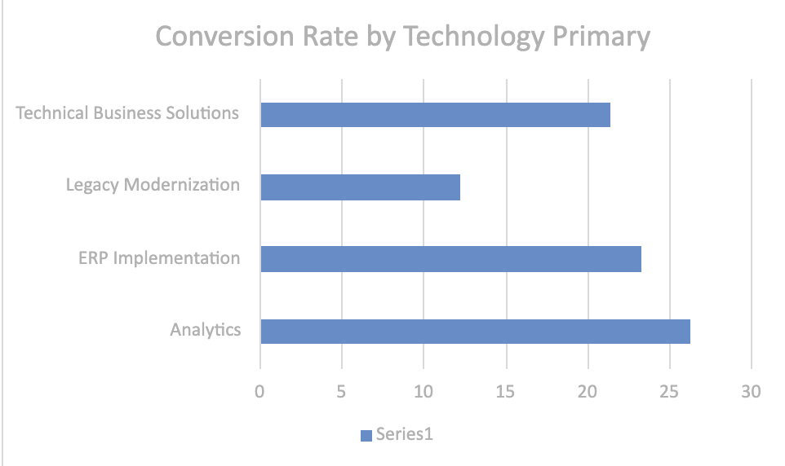
Sales Pipeline Conversion at a SaaS Startup
Variable under consideration: Technology Primary
Analytics → 26.3%
ERP Implementation → 23.3%
Technical Business Solutions → 21.4%
Legacy Modernization → 12.2%
Pattern: Exception / Outlier
Analytics has the highest conversion rate at 26.3% but makes up less than 1% of the total pipeline. Legacy Modernization is the worst performer at 12.2% and should be reviewed. ERP Implementation dominates volume at 64% of all leads — improving its conversion even slightly would have the biggest overall impact.
Notes:
For each variable that produced an interesting insight, explain you analysis bit here – the results you got from excel and the necessary visualisations. Note: it is compulsory for you to mention the results of the analysis on these variables - 'Technology Primary', 'B2B Sales Medium', 'Client Revenue Sizing', 'Opportunity Sizing' and 'Business from Client last year’.

Slide 11
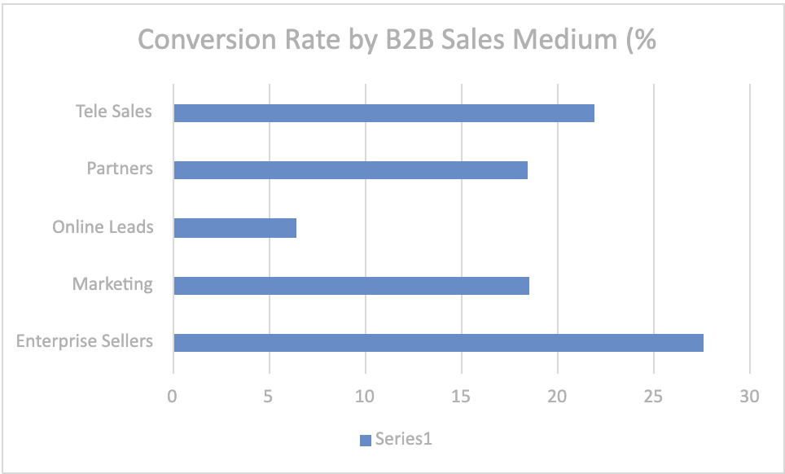
Sales Pipeline Conversion at a SaaS Startup
Variable under consideration:
Pattern: Magnitude / Outlier
Enterprise Sellers convert at 27.6% — the best performing channel. Online Leads are a critical problem at only 6.5% conversion — nearly 4 times worse. Immediate action is needed to either fix or defund the Online Leads channel and redirect that investment toward Enterprise Sellers.
Notes:
For each variable that produced an interesting insight, explain you analysis bit here – the results you got from excel and the necessary visualisations. Note: it is compulsory for you to mention the results of the analysis on these variables - 'Technology Primary', 'B2B Sales Medium', 'Client Revenue Sizing', 'Opportunity Sizing' and 'Business from Client last year’.

Slide 12
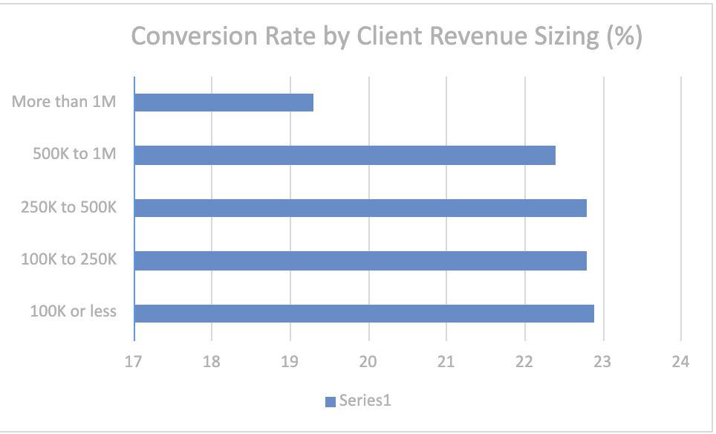
Sales Pipeline Conversion at a SaaS Startup
Variable under consideration:
Pattern: Inverse Trend
There is a clear inverse relationship between deal size and conversion rate. Deals of 10K or less convert at 39.9% while the 40K–50K range converts at only 11.7%. Most alarmingly the 40K–50K bucket is the largest volume segment in the pipeline yet has the worst conversion rate. TechnoServe is spending the most effort on the deals least likely to close.
Notes:
For each variable that produced an interesting insight, explain you analysis bit here – the results you got from excel and the necessary visualisations. Note: it is compulsory for you to mention the results of the analysis on these variables - 'Technology Primary', 'B2B Sales Medium', 'Client Revenue Sizing', 'Opportunity Sizing' and 'Business from Client last year’.

Slide 13
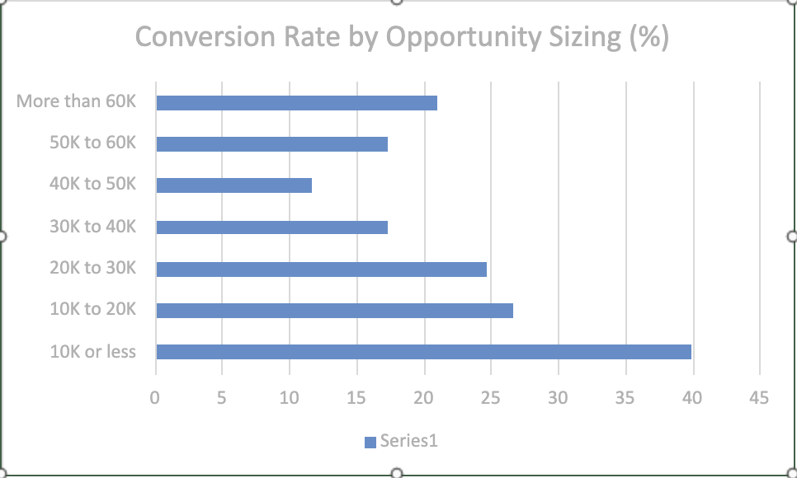
Sales Pipeline Conversion at a SaaS Startup
Variable under consideration:
Pattern: Strongest Trend / Magnitude
This is the strongest finding in the entire dataset. Clients with any prior business convert at 47–83% compared to only 17.3% for new clients. The problem is that 88% of the pipeline consists of brand new clients — the worst converting group. TechnoServe is largely ignoring its most valuable asset which is existing client relationships.
Notes:
For each variable that produced an interesting insight, explain you analysis bit here – the results you got from excel and the necessary visualisations. Note: it is compulsory for you to mention the results of the analysis on these variables - 'Technology Primary', 'B2B Sales Medium', 'Client Revenue Sizing', 'Opportunity Sizing' and 'Business from Client last year’.

Slide 14
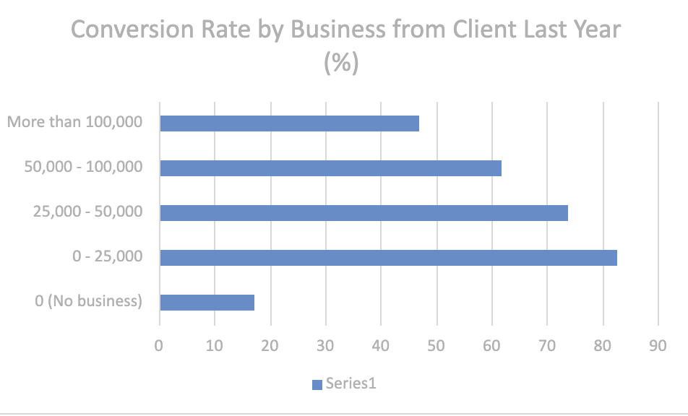
Sales Pipeline Conversion at a SaaS Startup
Variable under consideration:
Pattern: No Significant Pattern
Conversion rates are almost identical across all client revenue categories ranging from 19.3% to 22.9%. Client revenue size has no meaningful impact on whether a lead converts. TechnoServe should not waste time segmenting leads by client size and should instead focus on variables that actually matter like prior relationship and deal size.
Notes:
For each variable that produced an interesting insight, explain you analysis bit here – the results you got from excel and the necessary visualisations. Note: it is compulsory for you to mention the results of the analysis on these variables - 'Technology Primary', 'B2B Sales Medium', 'Client Revenue Sizing', 'Opportunity Sizing' and 'Business from Client last year’. Make more copies of this slide if needed.

Slide 15
Sales Pipeline Conversion at a SaaS Startup
Recommendations
R1: Invest in upselling existing clients Launch a structured programme to upsell and cross-sell to existing clients. Set a target to move more leads into the "prior business" category.
R2: Shift pipeline focus toward smaller deals Redesign sales targets to prioritise deals of 20K or less which convert far better. Reduce time spent on 40K–50K deals.
R3: Fix or eliminate the Online Leads channel Online Leads convert at only 6.5%. Immediately audit this channel and reallocate budget to Enterprise Sellers who convert at 27.6%.
R4: Scale up Analytics pipeline Analytics converts at 26.3% but has less than 1% of pipeline volume. Actively push more Analytics leads through marketing and sales.
R5: Review Legacy Modernization strategy At 12.2% conversion this product is underperforming. Either revamp the value proposition or redirect those sales resources elsewhere.
Corresponding Insights
R1 is based on the finding that prior clients convert at 47–83% vs 17.3% for new clients.
R2 is based on the inverse trend showing smaller deals convert far better.
R3 is based on Online Leads converting 4x worse than Enterprise Sellers.
R4 is based on Analytics having the highest conversion rate but lowest pipeline volume.
R5 is based on Legacy Modernization having the lowest conversion rate of all products.
Notes:
For each recommendation explain the insights that form the reasoning for giving that recommendation. Make more copies of this slide if necessary.

Slide 16
Sales Pipeline Conversion at a SaaS Startup
TechnoServe's conversion rate dropped to 22.6% due to 3 fixable root causes.
Root Cause 1: Wrong Channel Mix
Online Leads drag the overall rate down to 6.5% while Enterprise Sellers sit at 27.6% but are under-scaled.
Root Cause 2: Wrong Deal Size Focus
The largest volume segment (40K–50K deals) converts at only 11.7%. Small deals convert at 39.9% but are ignored.
Root Cause 3: Neglecting Existing Clients
88% of pipeline is new clients who convert at 17.3%. Existing clients convert at 47–83% but are underutilised.
SO WHAT - What we must do:
Reallocate investment from Online Leads → Enterprise Sellers
Rebalance pipeline toward smaller deals (≤ 20K)
Launch an upsell/retention programme for existing clients
Notes:
You are free to use the elements and boxes mentioned previously. Make sure you’re using the pyramid principle, data visualization, visual design principle and storyboarding concepts to design these slides.

Slide 17
Sales Pipeline Conversion at a SaaS Startup
These 3 variables explain most of the conversion drop and point directly to the solution.
Notes:
You are free to use the elements and boxes mentioned previously. Make sure you’re using the pyramid principle, data visualization, visual design principle and storyboarding concepts to design these slides.

Slide 18
Sales Pipeline Conversion at a SaaS Startup
Action Plan to Restore Conversion Rate to 35%+
Action 1: Upsell Existing Clients — Highest ROI
Prior clients convert 3–5x better. Invest in account management and upselling. Goal: shift 10% of pipeline to prior business status within 12 months.
Action 2: Shift to Smaller Deals
Increase proportion of deals under 20K from current levels to 50% of pipeline. Incentivise reps on faster closing smaller deals.
Action 3: Defund Online Leads — Scale Enterprise Sellers
Reallocate Online Leads budget to hire and train more Enterprise Sellers especially in Mumbai which is the best performing city.
Action 4: Fix Product Mix
Grow Analytics pipeline aggressively. Review and revamp Legacy Modernization value proposition within 6 months.
Notes:
You are free to use the elements and boxes mentioned previously. Make sure you’re using the pyramid principle, data visualization, visual design principle and storyboarding concepts to design these slides.

